Slide 1
Using machine learning to identify and understand the consequences of non-coding disease associated genetic variants
1

Slide 2
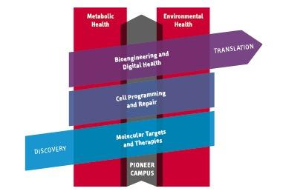


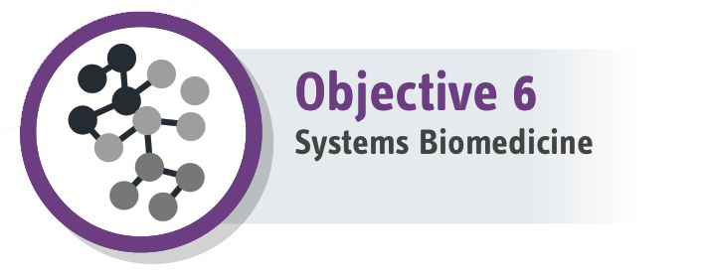


Our mission
Development and application of computational tools to identify regulatory networks underlying common diseases from multi-omics data
Resolving GWAS
Understanding variants
Regulatory networks
Human heart
Blood cells
Epigenetics
2
Notes:
My mission is the Development and application of computational tools,
to identify regulatory networks underlying common diseases,
from multi-omics data.
Click
My work is high relevance for the strategy of the center
Click
as my contributions constitute the building blocks for the center to move towards digital health.
Specifically, I am going to show you,
Click
how we help resolving GWAS to advance digital genomics,
Click (pause)
use applied AI to understand sequence variation,
Click (pause)
and develop new methods to reconstruct regulatory networks to advance systems biomedicine.
We applied our methods in two experimental systems:
Click
First, we studied Human blood cells. They are a major constituent of the immune system and play an important role in environmentally triggered diseases.
click
Second, we studied the human heart, which is affected as a complication of the metabolic syndrome.
Ruhiger (einordnene, schnell = aufregung), nicht so hoch sprechen!

Slide 3
This Assignment explains;
Machine learning to identify sequence variants
Basics of genome wide association studies (GWAS)
Systems genetics to make sense of GWAS
Machine learning to understand mechanisms of gene regulation
3

Slide 4
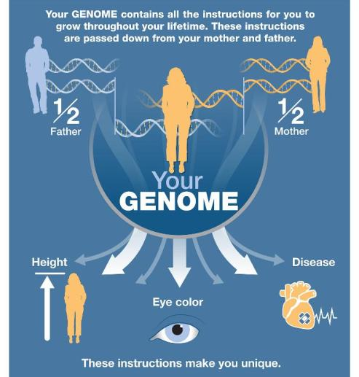
Your genome
https://www.genome.gov/about-genomics/teaching-tools/Your-Genome-You-infographic
4

Slide 5
Reading your genome using the next generation sequencing (NGS) Illumina workflow
https://www.youtube.com/watch?v=fCd6B5HRaZ8
5

Slide 6
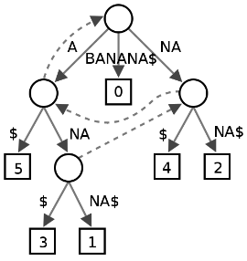
Read Mapping Problem
Reference sequence G
length g = 3 GB
(e.g. human genome)
Short sequences (reads) R
resulting from NGS
length r
Suffix trie
Memory O(20 g)
Lookup O(r)
Suffix array
O(4 g)
O(r log g)
Burrows Wheeler transform
FM-index
O(2g + g log₂ g / 32) ≈ 3.2Gb
O(r)
Suffix | i
$ | 7
a$ | 6
ana$ | 4
anana$ | 2
banana$ | 1
na$ | 5
nana$ | 3
6

Slide 7
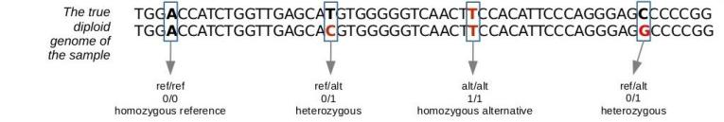
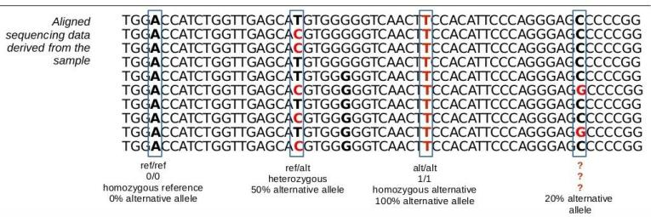
Using NGS data to identify variant positions and call genotypes
Alleles:
T (ref) C (alt)
Single nucleotide
polymorphism
maternal
paternal
genotypes
7

Slide 8
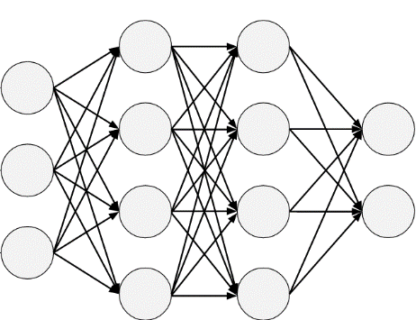
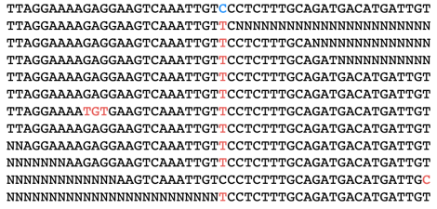
DeepVariant: Deep Learning approach to identify variants and call genotypes
Possible Variant
Output ”Probabilities”
Hom ref 0.01
Het 0.9
Hom alt 0.1
Neural Network
Poplin 2018 Nat Biotech
8

Slide 9
DeepVariant workflow
9

Slide 10
Encoding data for the Neural Network
Each variant is encoded as a 14-channel image
The channels encode properties
of each base in each read
reference genome
Image height=70
Reads pileup
Image depth (16 channels)
Image width=150

Slide 11


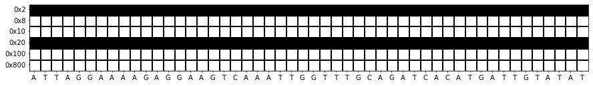
Encoding data for the Neural Network: image channels for a given read
One-hot encoding
of reference bases
P-hot encoding
of read bases
Image depth=70
Read quality flags
Image width=150

Slide 12
Evaluation of DeepVariant
12c

Slide 13
Complex traits
Genetics
Environment
Phenotype
Aims:
Identify genetic factors
Characterize their interplay with the environment
Understand the molecular mechanisms
13
Notes:
The Goal of our work is to undertand…
Überleitung von Publications zu inhalt

Slide 14
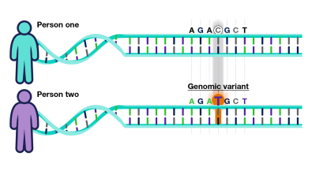
Genome wide association studies (GWAS) in a nutshell
Single nucleotide polymorphisms (SNP) = genetic marker
Alleles: different versions of the sequence (here C and T)
Genome(s)
Genotypes: combination of the alleles of the paternal and maternal chromosome
CC: homozygous C
CT: heterozygous
TT: homozygous T
Allele dosage: numeric encoding (e.g. number of T alleles)
CC: 0
CT: 1
TT: 2
14
Notes:
-> for monogenic/qualitative trait: compare allele frequencies (odds ratios) and calculate significance by chi-square test
-> for quantiative: linear regression (alternative ANOVA), possibility to add covariates such as age, gender, ...
-> polygenic risk score to combine multiple SNPs: usually by regression (maybe elastic net)

Slide 15

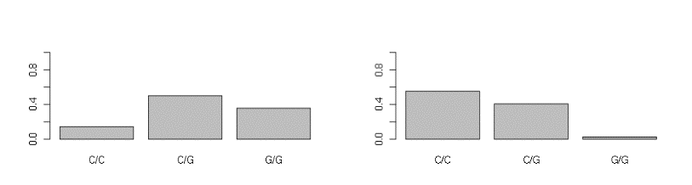
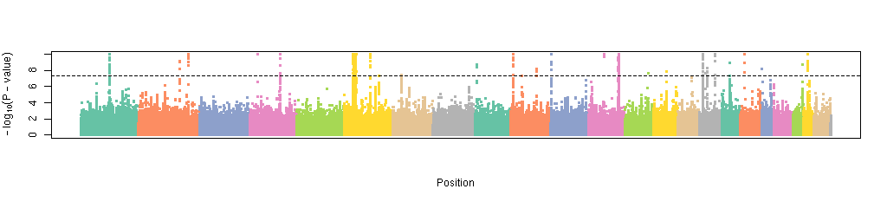
Genome wide association studies (GWAS) in a nutshell
Healthy
Diseased
Genome(s)
C/C
C/T
T/T
C/C
C/T
T/T
Genomic position
15
Notes:
-> for monogenic/qualitative trait: compare allele frequencies (odds ratios) and calculate significance by chi-square test
-> for quantiative: linear regression (alternative ANOVA), possibility to add covariates such as age, gender, ...
-> polygenic risk score to combine multiple SNPs: usually by regression (maybe elastic net)

Slide 16



Complex traits
Genetics
Environment
Genomewide association studies
“We don’t know anything”
2011 Craig Venter
Phenotype
1000s of variants with small effect sizes
95% non-protein-coding
Aggregation in polygenic risk scores highly predictive
To understand disease mechanisms we have to:
understand how 1000s of variants interact
understand the function of the non-protein-coding genome
16
Notes:
The Goal of our work is to undertand…
Überleitung von Publications zu inhalt

Slide 17
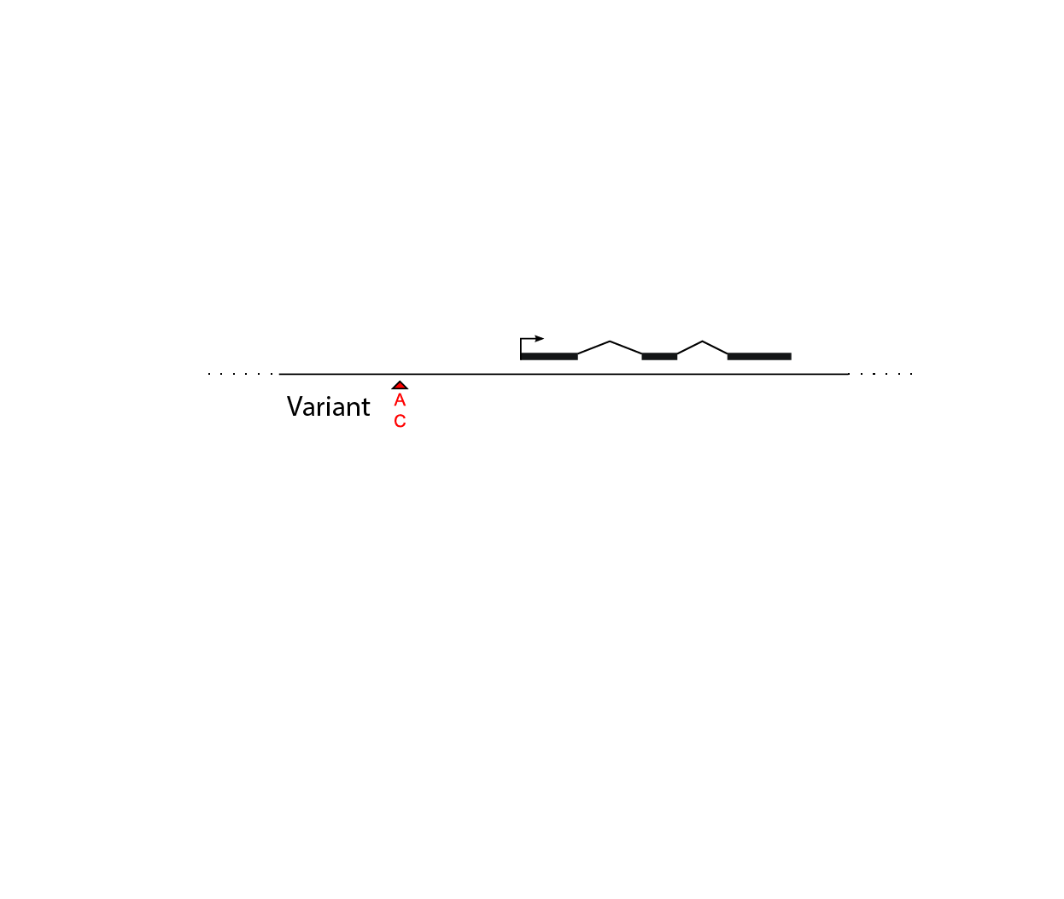
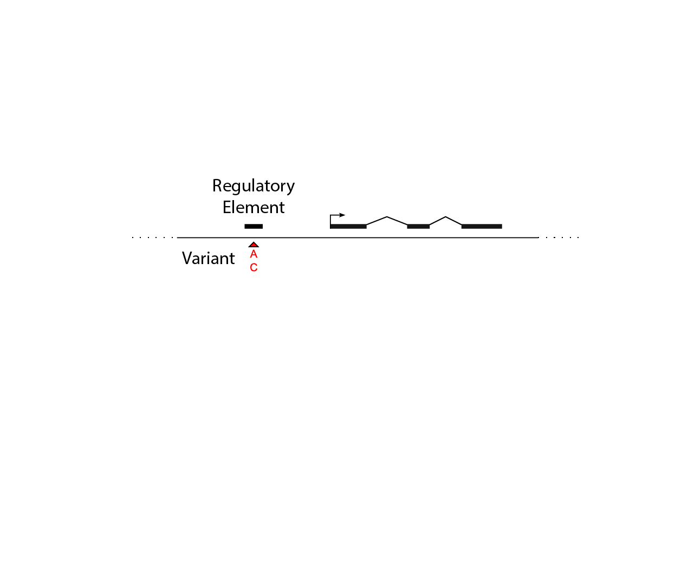
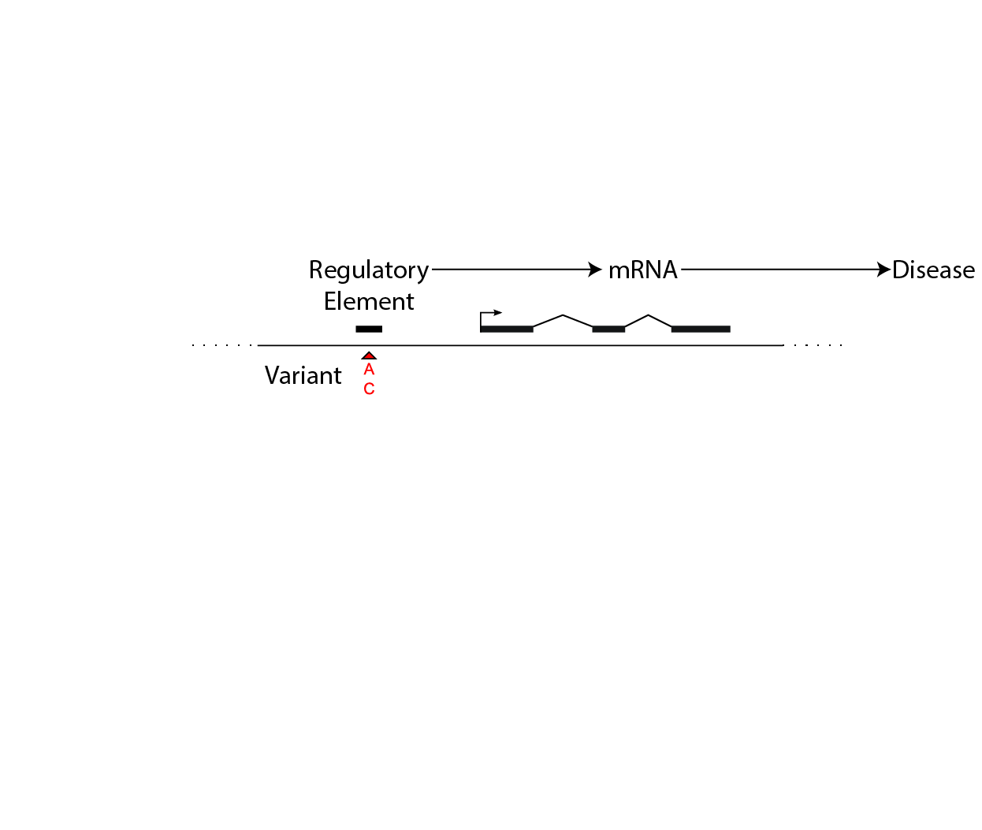
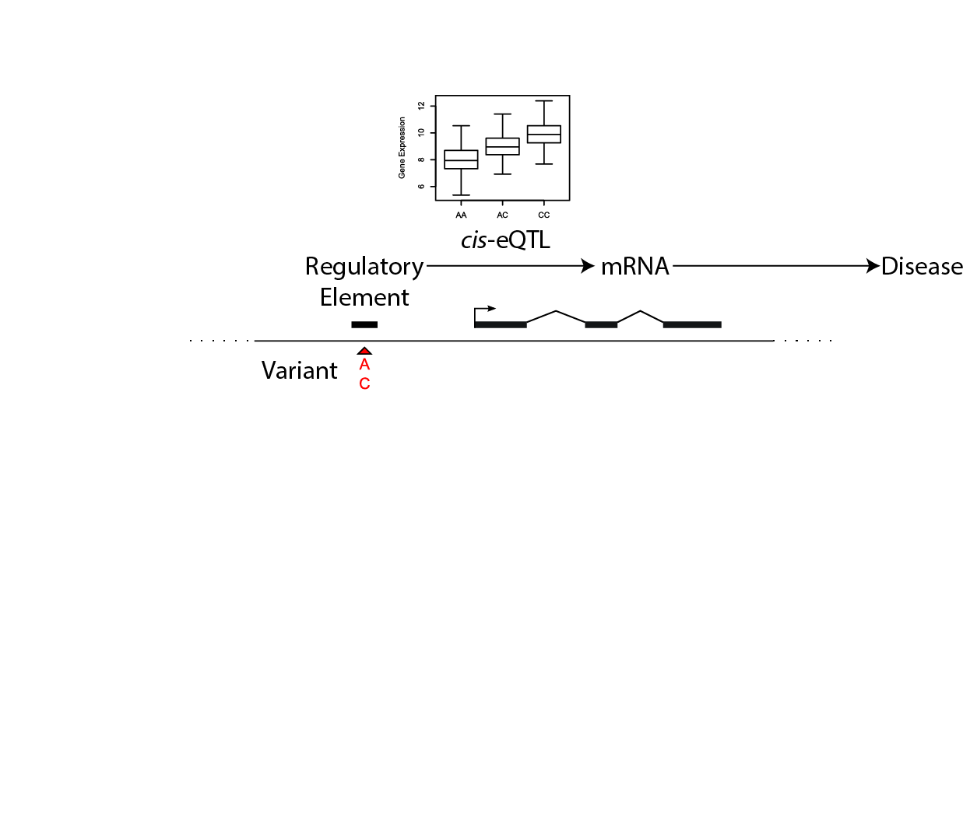
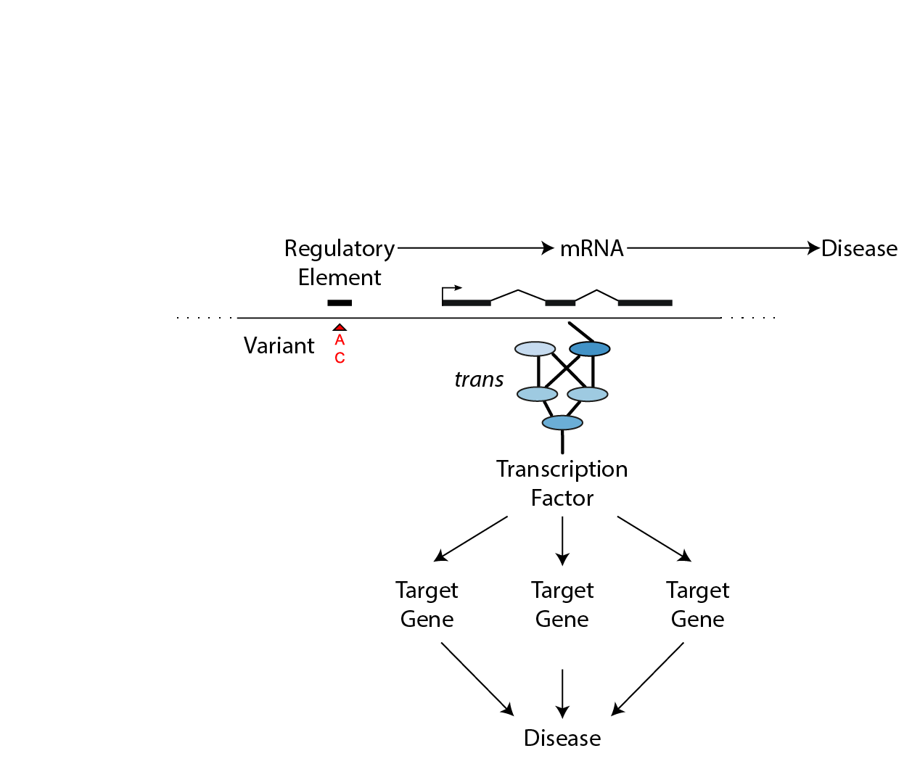
eQTL: understanding disease by understanding the non-coding genome
Disease
Protein
space
Transcript
space
Chromatin
space
Gene
space
17

Slide 18
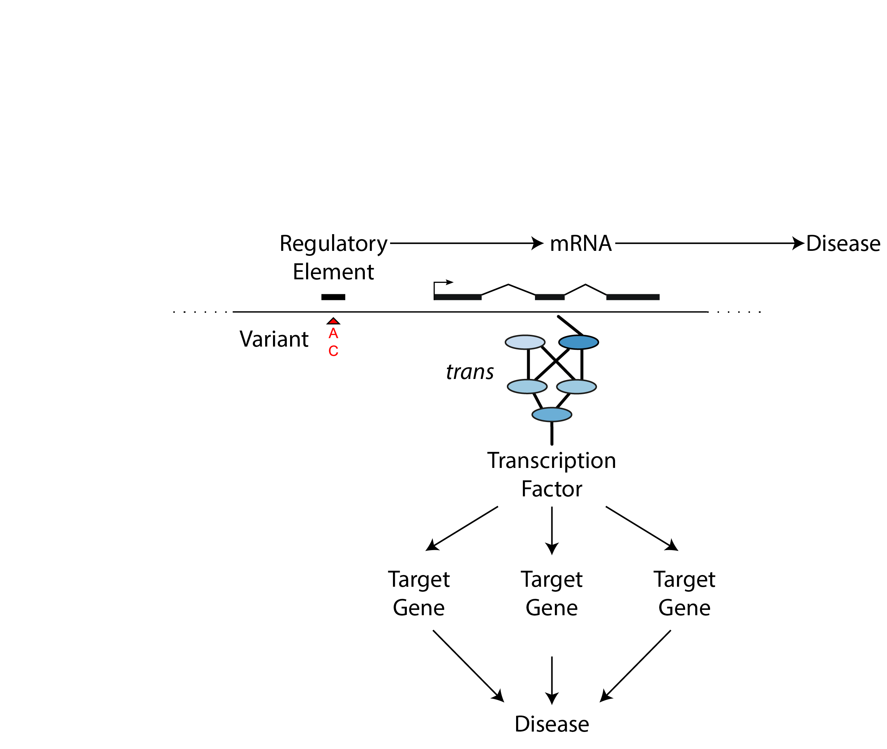
Systems genetics: understanding disease by understanding the non-coding genome
Systems genetics
Disease
Protein
space
Transcript
space
Chromatin
space
Gene
space
18

Slide 19
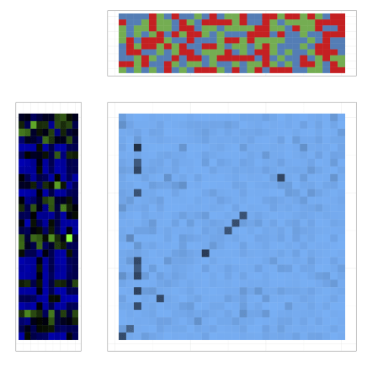
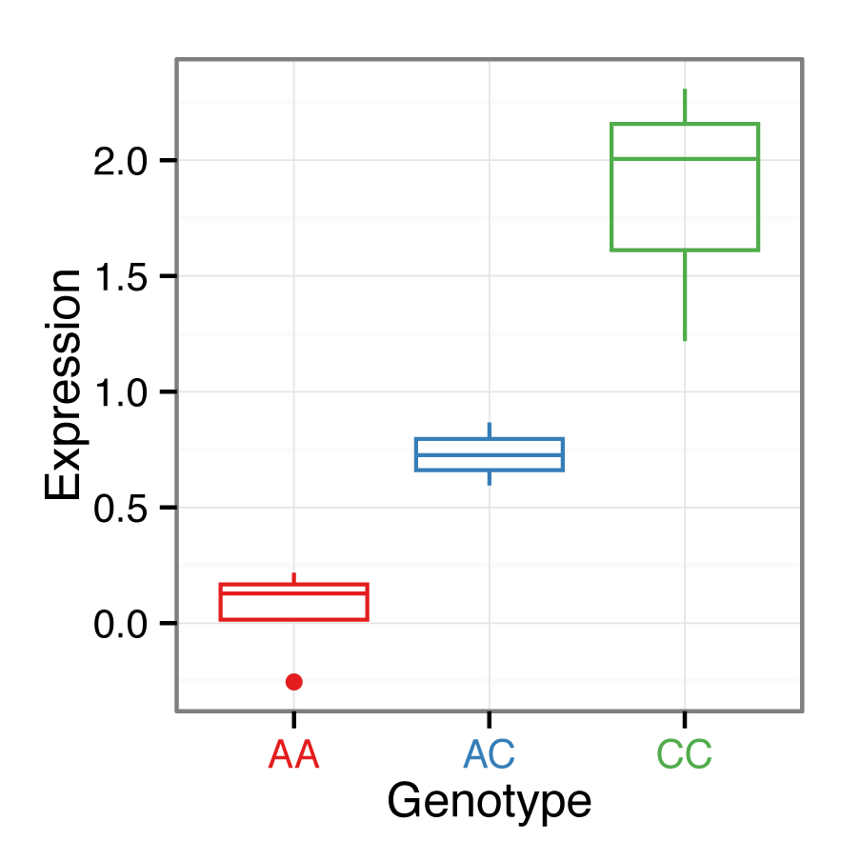
eQTL: expression quantitative trait loci
genome-wide genotypes
individuals
QTL model
genome-wide gene expression
gene
marker
19

Slide 20
cis eQTL
genome-wide genotypes
individuals
Evidence for cis regulation:
gene and eQTL marker
colocalize
marker tags regulatory variant
gene is target of regulatory variant
genome-wide gene expression
gene
marker
20

Slide 21
trans eQTL
genome-wide genotypes
individuals
Evidence for trans regulation:
gene and eQTL marker don’t
colocalize
one marker is associated to many genes
marker tags variant of trans factor
genes are likely targets of trans factor
genome-wide gene expression
gene
marker
21

Slide 22
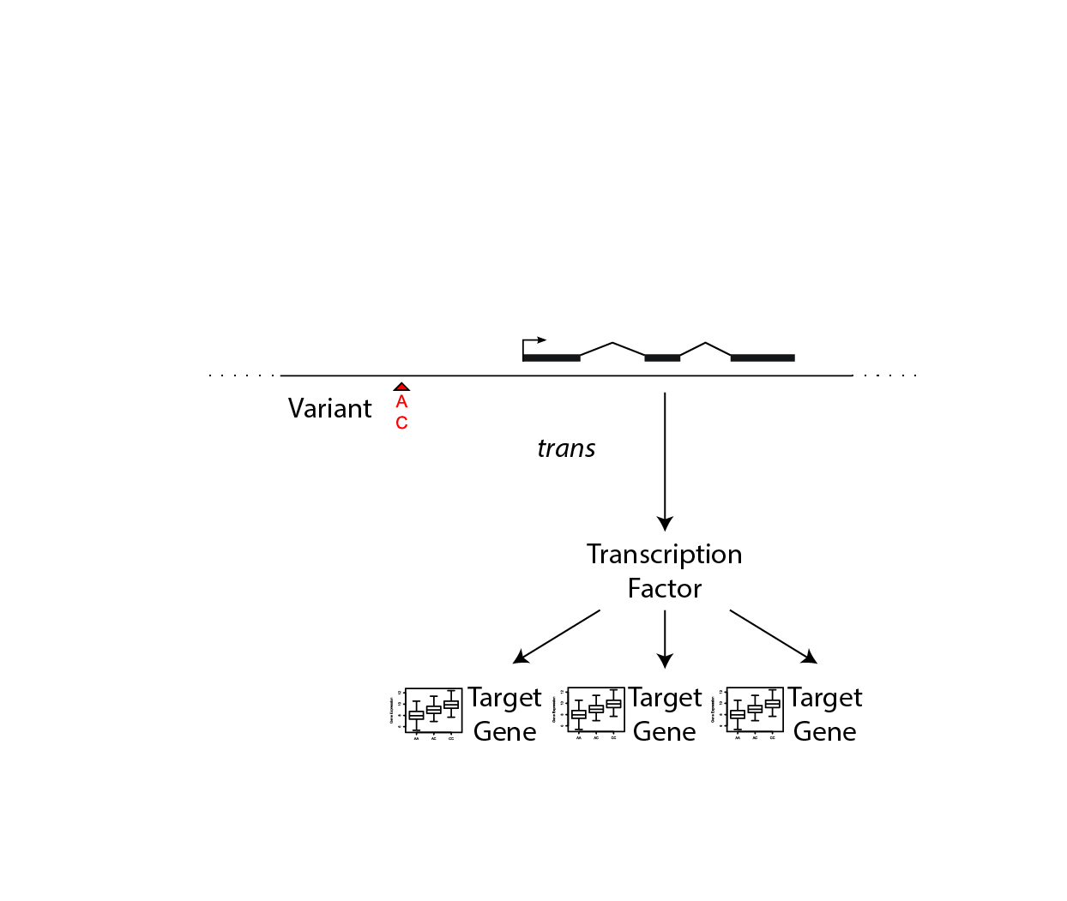
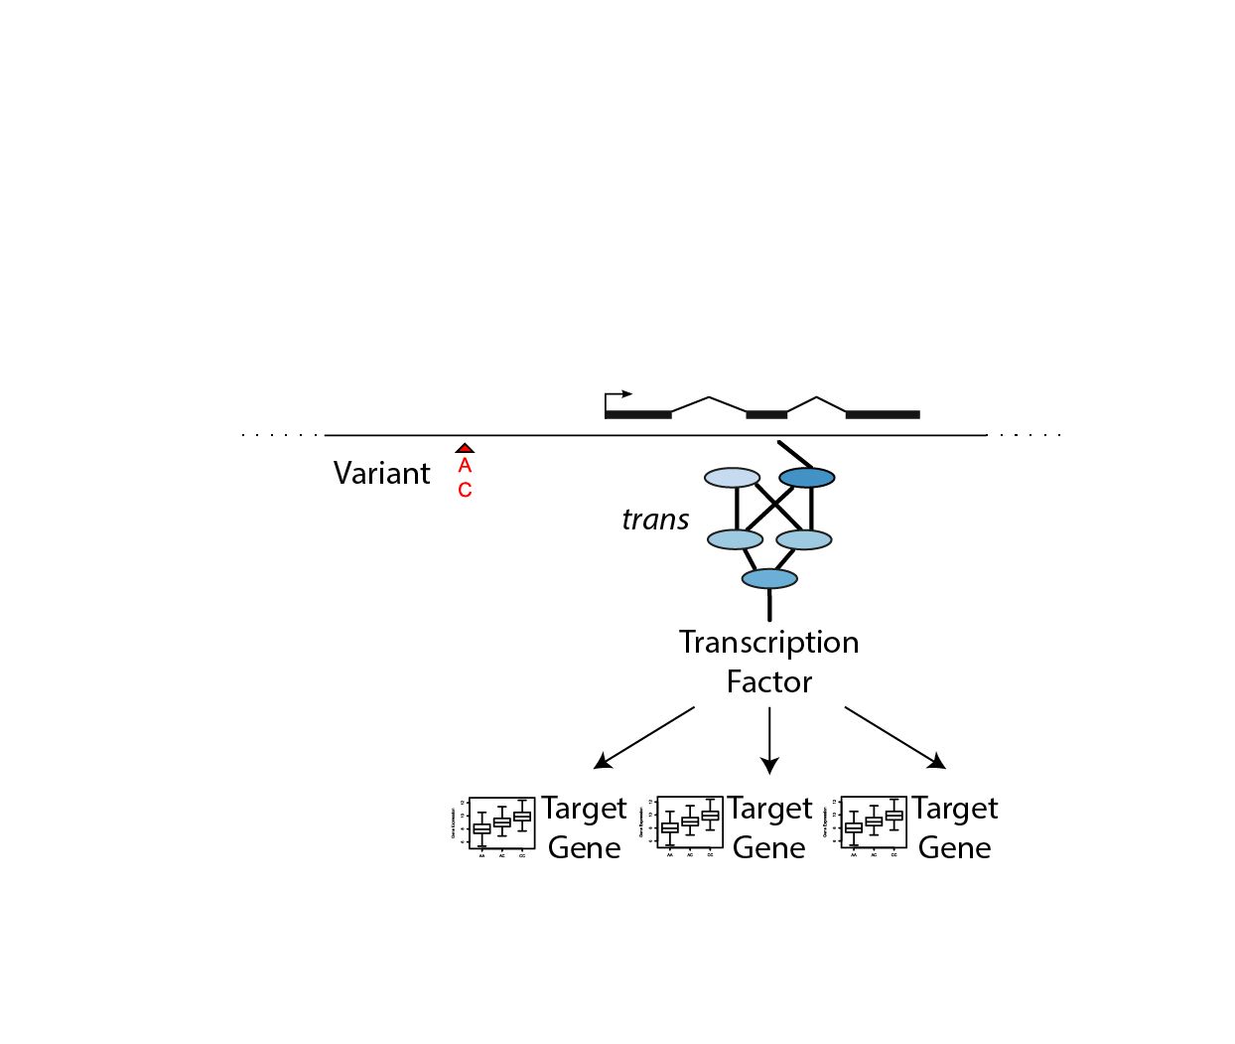




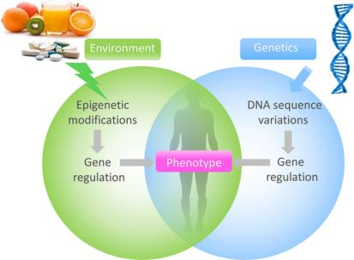
What mediates the trans effects on transcription factors?
John
Chambers
Christian
Gieger
Johann
Hawe
Melanie
Waldenberger
?
22

Slide 23

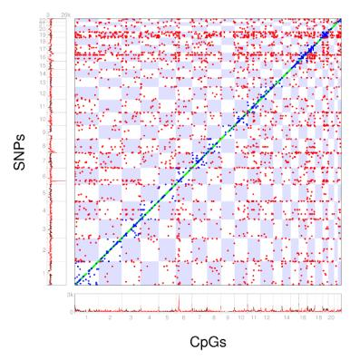
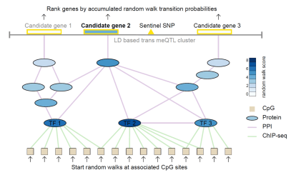
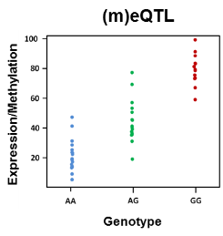
Regulatory networks underlying the genetics of DNA methylation
N ~ 3700
N ~ 3200
Significant SNP – CpG associations (meQTL)
Johann
Hawe
trans meQTL (hotspot)
ca. 11x10⁶ pairs
Hawe, …, Heinig*, .. (co-last) in press Nature Genetics
23
Notes:
Now, we have such trans-meQTLs available from a joint analysis of two large cohorts, KORA and LOLIPOP. Both have over 3000 whole blood samples available, in which genotypes, gene expression and DNA methylation were measured.
Here you can see the 3000 replicated trans-meQTL, and for some them, like this one here, you can see that a single SNP is associated with a large number of CpGs in trans.
Hypothesis: Coordinated changes over the genome as result of regulatory networks -> identify networks
LOLIPOP: ca 3200
KORA: ca 3800

Slide 24

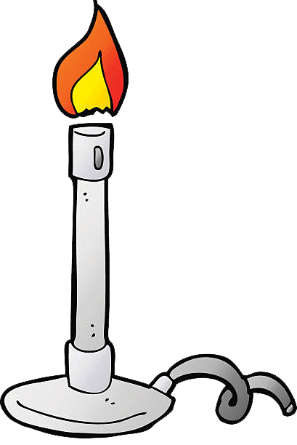
Regulatory networks underlying the genetics of DNA methylation
measure temperature
at each trans gene
Significant SNP – CpG associations (meQTL)
Johann
Hawe
trans meQTL (hotspot)
random walk
≙
heat diffusion
ca. 11x10⁶ pairs
heat up
trans linked CpGs
24
Notes:
Now, we have such trans-meQTLs available from a joint analysis of two large cohorts, KORA and LOLIPOP. Both have over 3000 whole blood samples available, in which genotypes, gene expression and DNA methylation were measured.
Here you can see the 3000 replicated trans-meQTL, and for some them, like this one here, you can see that a single SNP is associated with a large number of CpGs in trans.
Hypothesis: Coordinated changes over the genome as result of regulatory networks -> identify networks
LOLIPOP: ca 3200
KORA: ca 3800

Slide 25
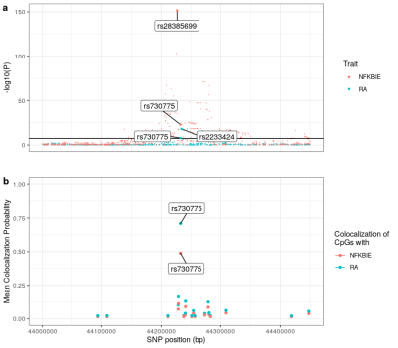
A rheumatoid arthritis locus regulates DNA methylation via NFKBIE
Hawe, …, Heinig*, .. (co-last) in revision Nature Genetics
25
Notes:
No funct data for random walk
Telomeric connection(?)
For example by using a random walk based approach, so only relying on associations/meQTLS, ChIP-seq and PPIs, we can already identify regulatory networks as shown here. Now, if we enrich this with functional data which we did not use during the inference step, …
Regulatory networks identified using the random walk approach. The networks (a, b) illustrate the connections between the genotype at SNPs (yellow rectangle), the identified candidate genes (yellow ellipse), which are connected through a network of protein-protein and protein-DNA interactions to methylation at the trans-associated CpG sites (beige rectangles), and the expression of genes encoded at the CpG sites. Ellipses represent genes: i. encoded at the genetic locus identified by the sentinel (yellow fill), ii. encoded at the CpG loci (beige border) or iii. part of the protein-protein interaction network (black border). For genes in the protein-protein interaction network, fill colour of ellipses represents the random walk score as indicated in the colour bar legend. Edges connecting genes, SNPs and CpG sites represent: i. protein-protein interactions, ii. protein-DNA interactions identified by TFBS overlap and iii. genomic proximity (<1Mb). Bold edges indicate significant correlation with gene expression. c) Boxplots show the effect of the sentinel SNP (rs9859077) in cis on expression of the candidate gene SENP7 locus, and in trans on the genes at CpG loci (ZNF418, ZNF135, ZNF256, ZNF552, ZSCAN18, ZNF671, ZNF329, ZNF274, ZNF154, LDHD and ZNF814). Center lines indicate the medians, lower and upper box limits correspond to the first and third quartiles, respectively; whisker extents indicate 1.5-fold interquartile ranges; outliers not shown.

Slide 26
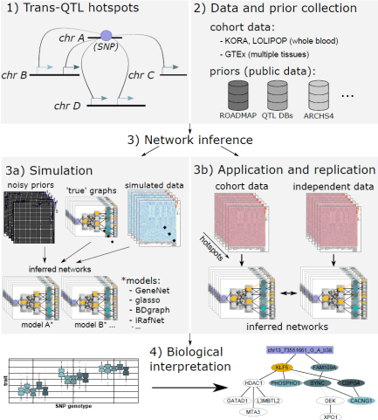
Bayesian GGMs identify QTL networks from quantitative data and network priors
Simulation study
Prior guided methods better
Robust to noise
Cross cohort replication
Prior guided methods better
Biological interpretation
Prioritization of novel GWAS candidates
Lean body mass
Schizophrenia
Hawe, …, Heinig under review at Genome Medicine
26

Slide 27




















Acknowledgements
Christian
Gieger
Melanie
Waldenberger
Elisabeth
Binder
Julien
Gagneur
Tanja
Zeller
Alexis
Battle
John
Chambers
Lude
Franke
Henriette
Uhlenhaut
Janine
Arloth
Stephan
Hutter
Heribert
Schunkert
Renate
Schnabel
Connie
Bezzina
Stuart
Cook
Eleftheria
Zeggini
Na
Cai
Wolgang
Wall
Daniel
Rückert
Norbert
Hübner
27

